Slide 1
IT 304
Computer Networks Fundamentals Week 1-Lecture 2

Slide 2
What is a computer network?
A set of network elements connected together, that implement a set of
protocols for the purpose of sharing resources at the end hosts
•
Three important components:
•
Core infrastructure:
• A set of network elements connected together
Protocols:
• Needed to use the network
Purpose:
Sharing resources at the end hosts (computing devices)
•
•

Slide 3
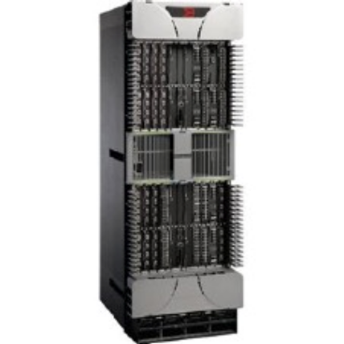

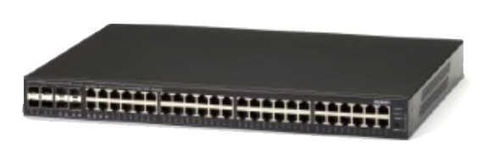
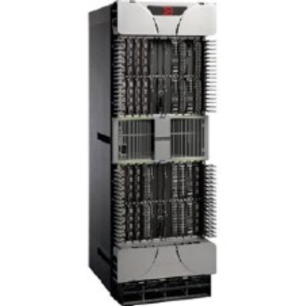

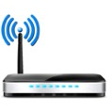
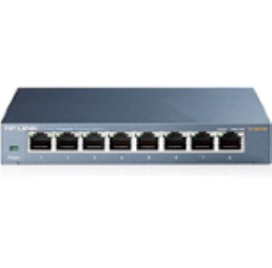





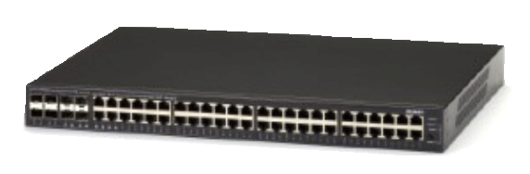
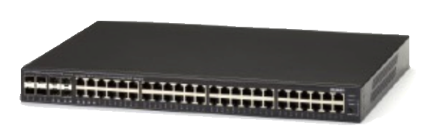
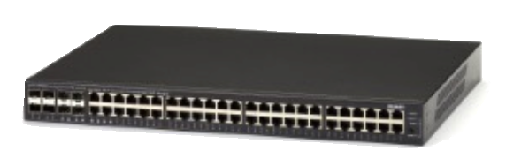


What is a computer network?
A set of network elements connected together, that implement a set of
protocols for the purpose of sharing resources at the end hosts

Slide 4
What do computer networks do?
A computer network delivers data between the end points/hosts
•
One and only one task: Delivering the data
•
This delivery is done by:
•
•
Chopping the data into packets
Sending individual packets across the network
• Reconstructing the data at the end points
Evolution of three components of computer networks!
• Infrastructure, protocols, purpose

Slide 5
















A closer look at network structure:
network edge:
hosts: clients and servers
servers often in data centers
mobile network
global ISP
access networks, physical media: wired, wireless communication links
home
network
regional ISP
network core:
interconnected routers
network of networks
institutional
network

Slide 6
Roadmap
1.1 what is the Internet?
1.2 network edge
end systems, access networks, links
1.3 network core
packet switching, circuit switching, network structure
1.4 delay, loss, throughput in networks
1.5 protocol layers, service models
1.6 networks under attack: security
1.7 history
Notes:
6

Slide 7









The network core
mesh of interconnected routers
packet-switching: hosts break application-layer messages into packets
forward packets from one router to the next, across links on path from source to destination
each packet transmitted at full link capacity

Slide 8
Many mechanisms: What do we mean by …
Locating a destination? →Naming, Addressing
Finding path to the destination → Routing
Sending data to the destination → Forwarding
Failures, reliability,etc..→ Distributed routing and congestion control

Slide 9







A computer network can be abstractly represented as a graph
Source
Path
Path
Source
Destination
Destination

Slide 10
How GOOD is a NETWORK?

Slide 11
What do we look at before commuting to places?
Which are the possible routes to take from DAIICT to home?
Which one is the best?
How long does it take to reach my home from DAIICT?
What is the capacity of a road(s) between DAIICT and home?

Slide 12
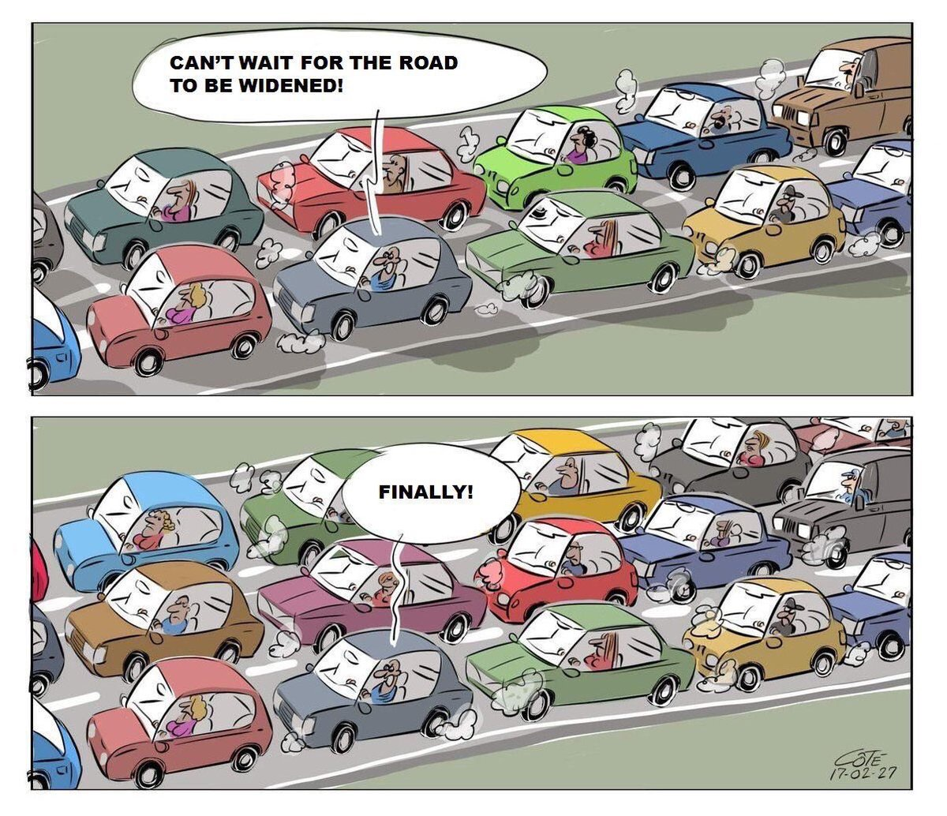
Capacity
How wide is the road?
How fat is the tunnel?
How many cars can fit at a time?
One, two, three…?

Slide 13
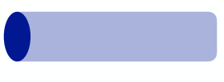
Performance metrics in computer networks!
Capacity is Bandwidth: Number of bits sent per unit time (bits per second, or bps)
• Depends on
• Hardware
• Network traffic conditions
Bandwidth
Time taken is Propagation delay: Time for one bit to move through the link (seconds)
• Depends on
•
•
Hardware
Network traffic conditions
Propagation
Delay
• How large is the unit?

Slide 14
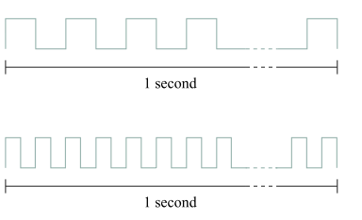
Bandwidth
Each bit is a pulse of some width.
For example, each bit on a
1-Mbps link is 1 µs wide
2-Mbps link is 0.5 µs wide,
The narrower each bit can become, the higher the bandwidth.
This means more bits can get inside the tunnel
So MORE DATA CAN FLOW WITHIN A TIME

Slide 15
Bandwidth-delay product (BDP)
Number of bits “in flight” at any point of time (bits)
• Bits sent, but not received
Bandwidth
Bandwidth x delay
Propagation
Delay
•
Same city over a slow link
•
Bandwidth: ~100Mbps
• propagation delay: ~0.1ms
• BDP = 10,000 bits (1.25KBytes)
Between cities over fast link:
• Bandwidth: ~10Gbps ,
propagation delay: ~10ms
• BDP = 100,000,000 bits (12.5MBytes)

Slide 16
Fun facts

Slide 17
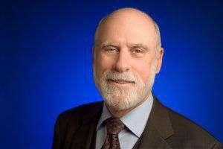
Google celebrates its birthday on September 27, although no one really knows the exact date when it was founded. Started by two Stanford college friends, Larry Page and Sergey Brin, in 1998, it is a multi-billion dollar enterprise now. The name comes from a simple misunderstanding when they were searching for another, actual, word that existed in academia and meant a particular number. What word is that and what number does it denote?
Googol, 1 followed by 100 zeros
Gmail was launched by Google on April 1, 2004, which led many to believe it was an April Fool’s joke. Before this service the term ‘G-mail’ already existed from as early as 1998. This was used online by fans of a certain fictional obese cat, and the original G-mail was known as “e-mail with cattitude”. What does the G stand for in the original G-mail?
Garfield
When Page and Brin built the first server rack for Google at Stanford, they were looking for a cabinet to house it that was easy to assemble and disassemble. The server contained ten 4GB hard disks and two cooling fans. What colourful and bountifully found system did they use to build the server stack?
Lego bricks
Who is the father of the Internet?
Vincent Cerf

